Slide 1

Project 2: Housing price prediction model

Slide 2
TABLE OF CONTENTS
01
PROBLEM STATEMENT
02
DATA CLEANING
03
EXPLORATORY DATA ANALYSIS
04
MODELING
05
CONCLUSION

Slide 3

PROBLEM STATEMENT
TO DISCOVER THE FACTORS AFFECTING SALE PRICE AND A MODEL FOR PREDICTION OF THE PRICE

Slide 4
TABLE OF CONTENTS
01
PROBLEM STATEMENT
02
DATA CLEANING
03
EXPLORATORY DATA ANALYSIS
04
MODELING
05
CONCLUSION

Slide 5
DATA CLEANING
YEAR GARAGE BUILT
TO CONVERT NULL VALUE WITHOUT LOSING THE LINEAR RELATIONSHIP

Slide 6
DATA CLEANING
LOT FRONTAGE
REPLACE ALL MISSING VALUES WITH DATA MEDIAN

Slide 7
TABLE OF CONTENTS
01
PROBLEM STATEMENT
02
DATA CLEANING
03
EXPLORATORY DATA ANALYSIS
04
MODELING
05
CONCLUSION

Slide 8
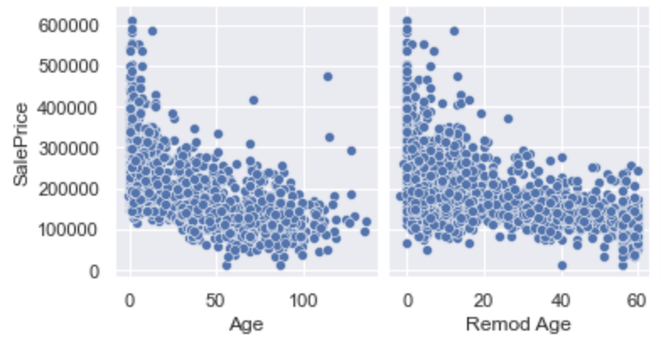
DATA CLEANING
CONVERTING YEARS TO AGE

Slide 9
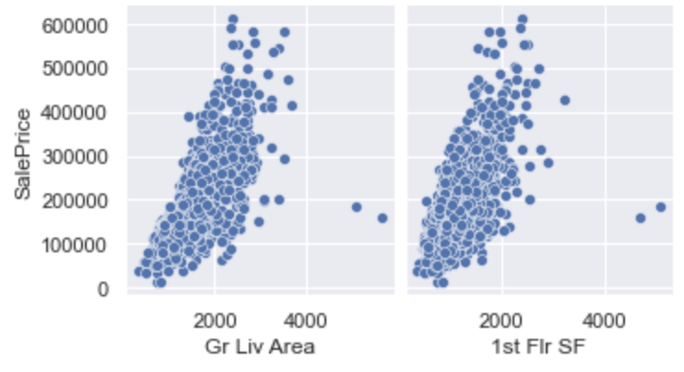
EXPLORATORY DATA ANALYSIS
HETEROSCEDASTICITY

Slide 10
TABLE OF CONTENTS
01
PROBLEM STATEMENT
02
DATA CLEANING
03
EXPLORATORY DATA ANALYSIS
04
MODELING
05
CONCLUSION

Slide 11
Feature Selection

Slide 12
Model Selection

Slide 13
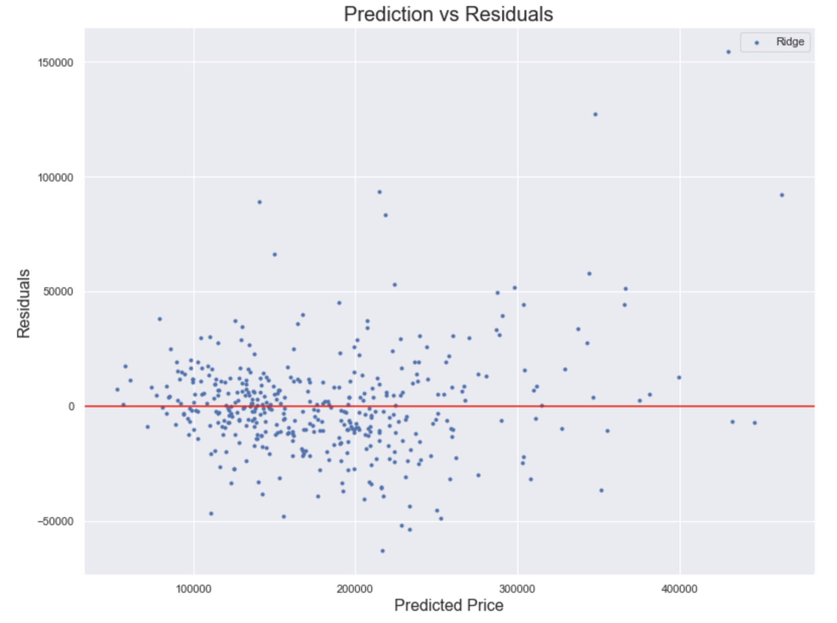
Model Selection
LINE ASSUMPTION IS TRUE FOR PRICE <$300000

Slide 14
TABLE OF CONTENTS
01
PROBLEM STATEMENT
02
DATA CLEANING
03
EXPLORATORY DATA ANALYSIS
04
MODELING
05
CONCLUSION

Slide 15


POSTIVE RELATION
FEATURES
HOUSING SPACE
HOUSING QUALITY
Single Family Detached
Hillside
Exterior Brick Face
Notes:
Housing Space
Above Grade Living Area,1st Floor Squared Feet, 2nd Floor Squared Feet, Garage Car, Basement Full Bath,Screen Porch area
House Quality-
Overall Quality, Overall Condition, Functional, Exterior Quality, Basement Qualilty, Rating of Basement Finish Type 1, Heating Quality

Slide 16
POSTIVE RELATION
Neighborhood
MS Zoning
Stone Brook
Northridge Heights
Crawford
Somerset
Brookside
Residential Low Density
Floating Village Residential
Notes:
Housing Space
Above Grade Living Area,1st Floor Squared Feet, 2nd Floor Squared Feet, Garage Car, Basement Full Bath,Screen Porch area
House Quality-
Overall Quality, Overall Condition, Functional, Exterior Quality, Basement Qualilty, Rating of Basement Finish Type 1, Heating Quality

Slide 17
FEATURES
Neighborhood
MS Zoning
NEGATIVE RELATION
Exterior Asbestos Shingles
Banked Contour
Edwards
Commerical
Notes:
Housing Space
Above Grade Living Area,1st Floor Squared Feet, 2nd Floor Squared Feet, Garage Car, Basement Full Bath,Screen Porch area
House Quality-
Overall Quality, Overall Condition, Functional, Exterior Quality, Basement Qualilty, Rating of Basement Finish Type 1, Heating Quality

Slide 18
THANKS

